Slide 1
????
Why are we even here?

Slide 2
Data Science?
Let’s find out...

Slide 3


Slide 4
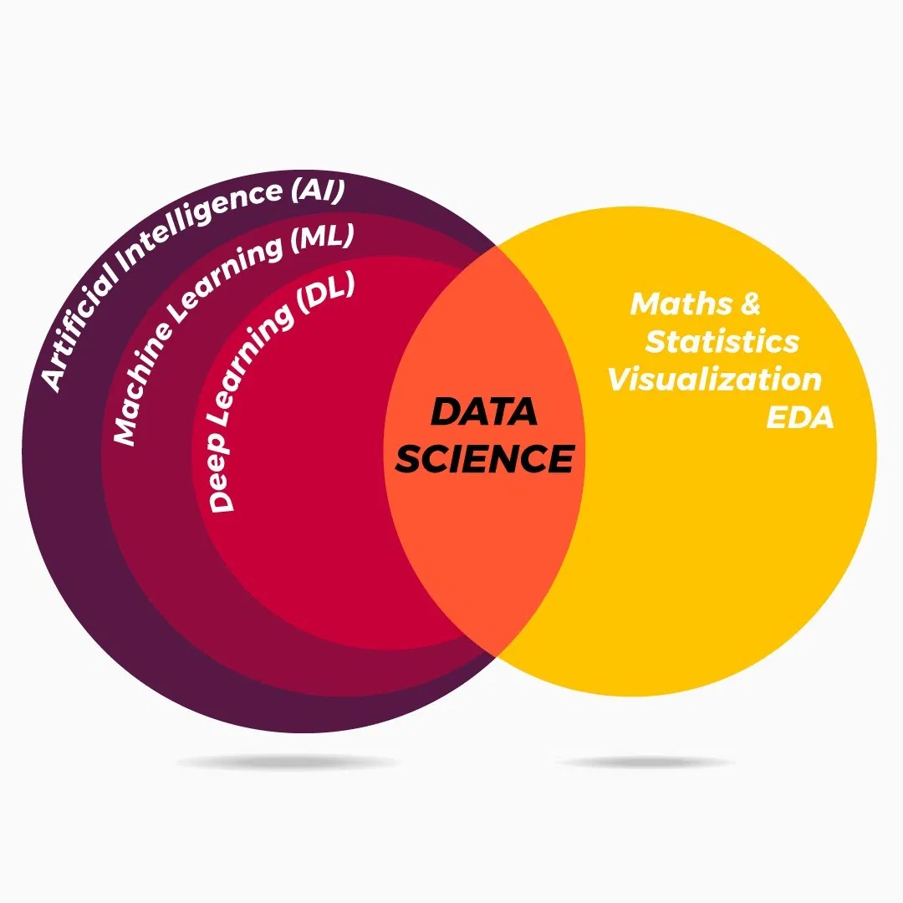

Slide 5
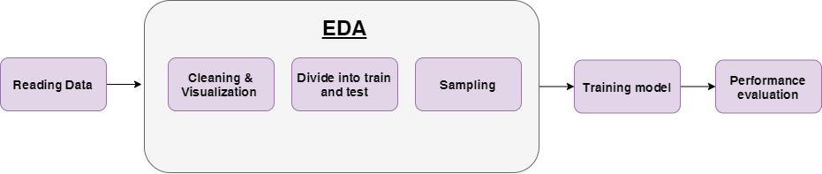

Slide 6
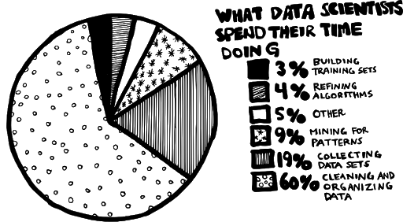

Slide 7

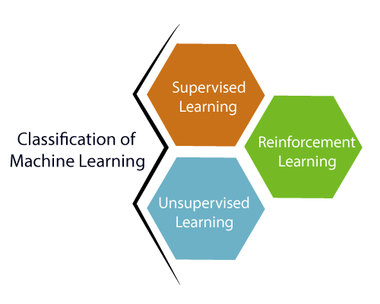

Slide 8
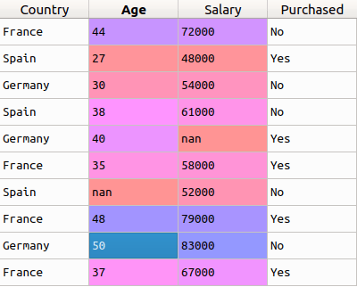
A few terminologies...

Slide 9
EDA
Exploratory Data Analysis

Slide 10
Linear Regression
An act of regression

Slide 11
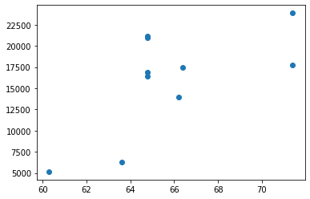
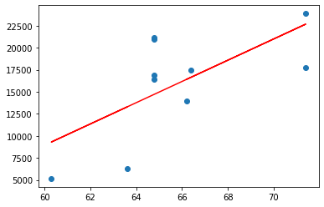

Slide 12
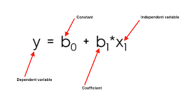
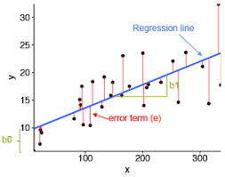
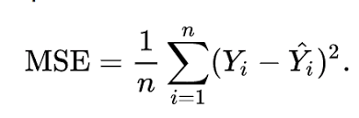

Slide 13
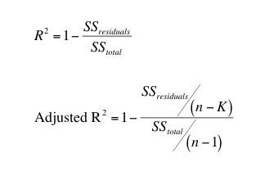
R^2 & Adjusted R^2

Slide 14
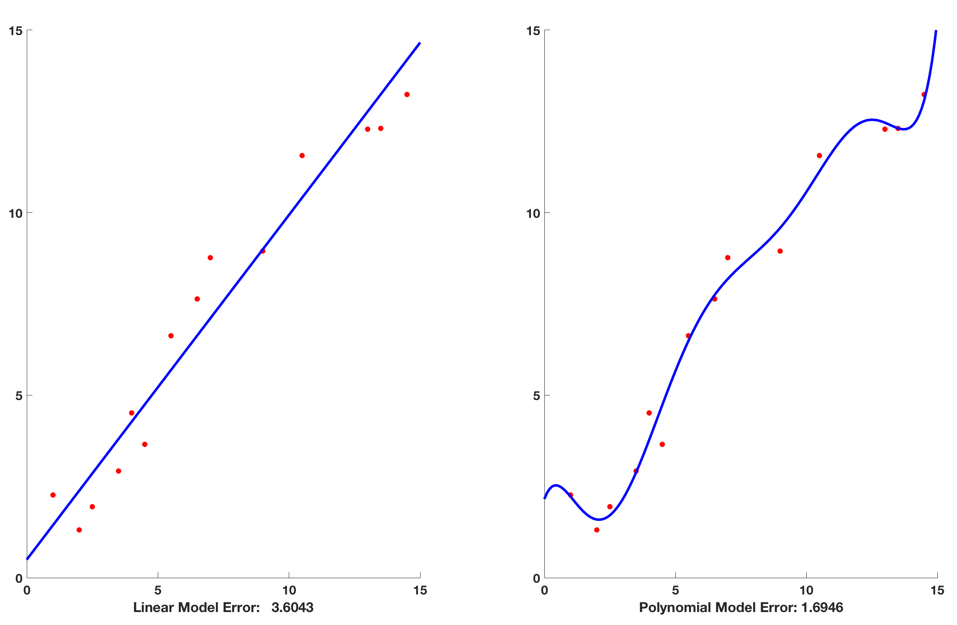
Bias Variance Tradeoff

Slide 15
Logistic Regression
Another act of regression

Slide 16
Introduction
Logi needs categories
Can’t use linear because limit is [-infinity,+infinity].
Logi needs limit [0,1]
So we need to transfom the equation to fit between 0 and 1
We do that using the Sigmoid function
Difference between logi and linear
Logi predicts Y-value using sigmoid curve
Logi is Classigication

Slide 17
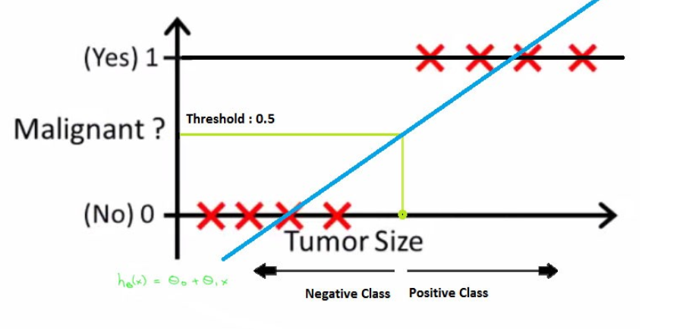
Why not Linear Regression?

Slide 18
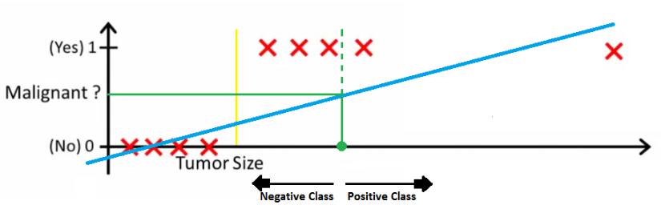

Slide 19
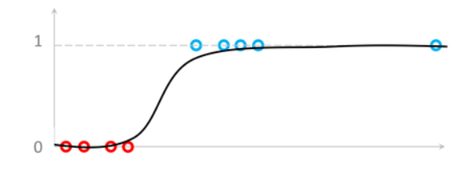
Real graphs have curves….

Slide 20
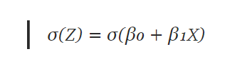
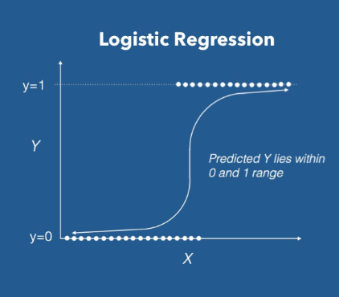
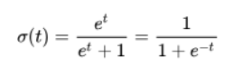
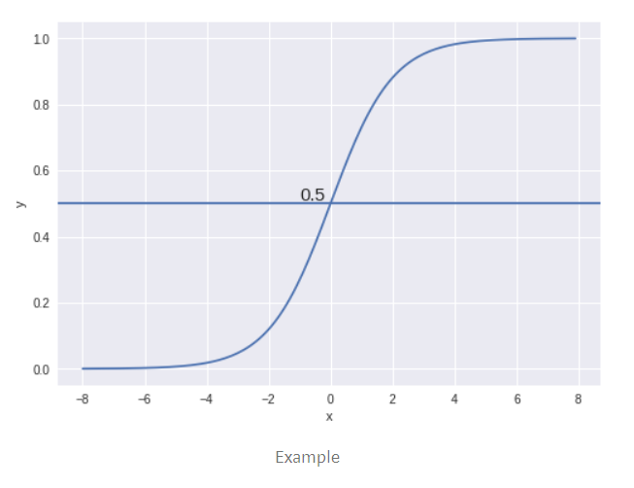

Slide 21
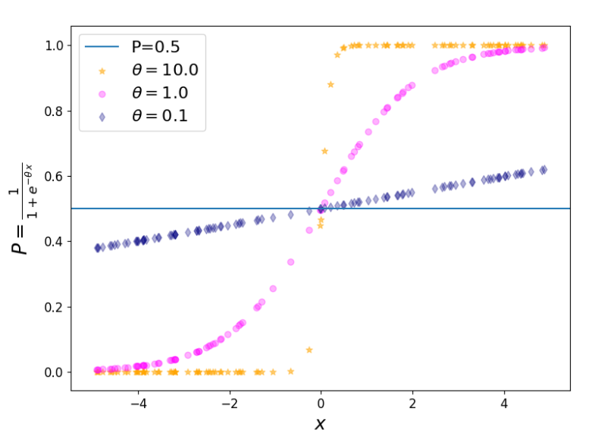
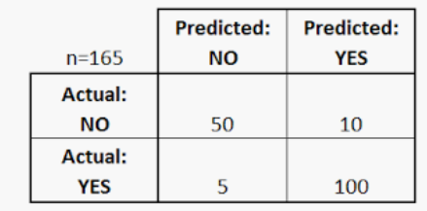

Slide 22
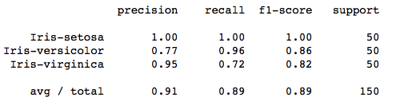
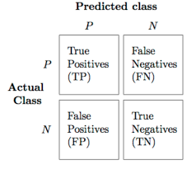
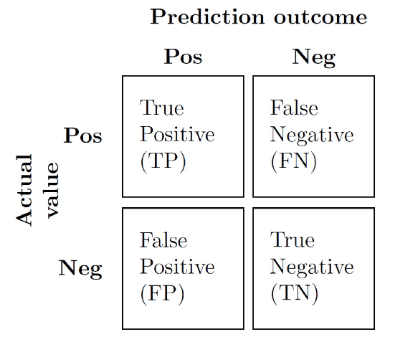
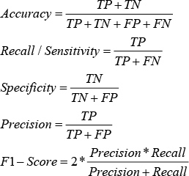
Performance metrics

Slide 23
SVM
I support vector machines

Slide 24
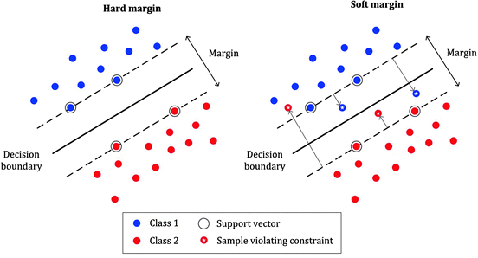

Slide 25
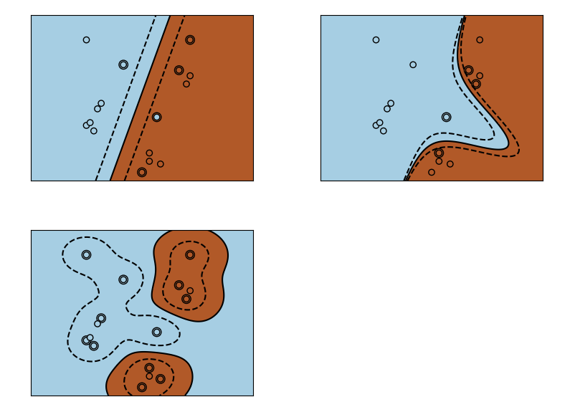

Slide 26
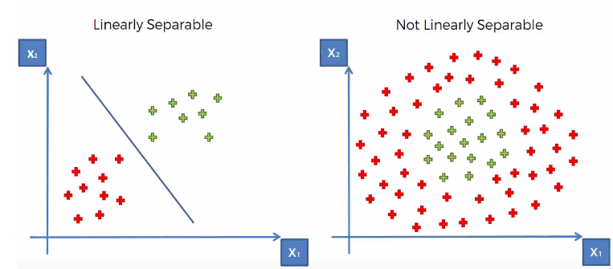

Slide 27
KNN
Love thy nearest neighbour

Slide 28
KNN is a simple algo that stores all the available cases and classifies the new data or case based on a similarity measure. Basically if you are similar to your neighbours then you are one of them. Right? Example if hriday looks more similar to another guy like me, then most probably he belongs to the class “MALE”.
The k in KNN denotes the number of nearest neighbours which will be checked.
Example of KNN search = Recommender systems on sites like Amazon. 30% of amazon’s revenue is generated from direct marketing.

Slide 29


Slide 30
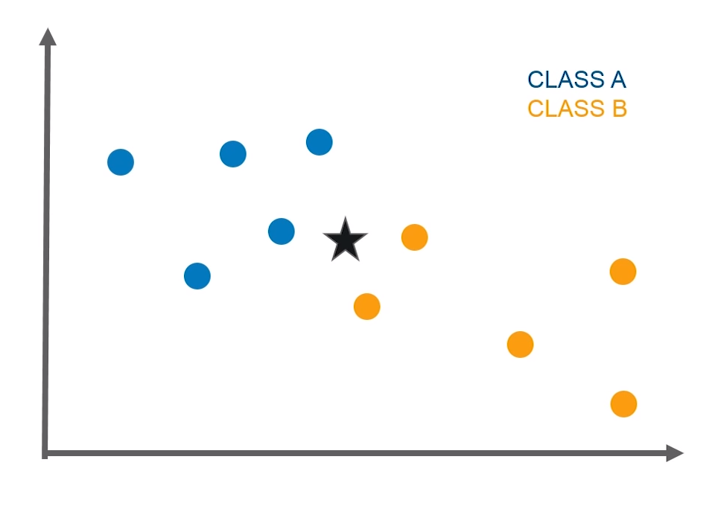

Slide 31
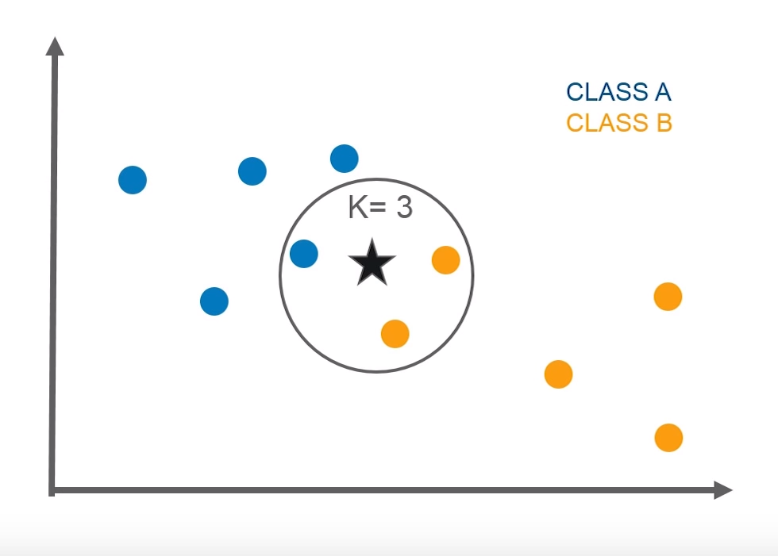

Slide 32
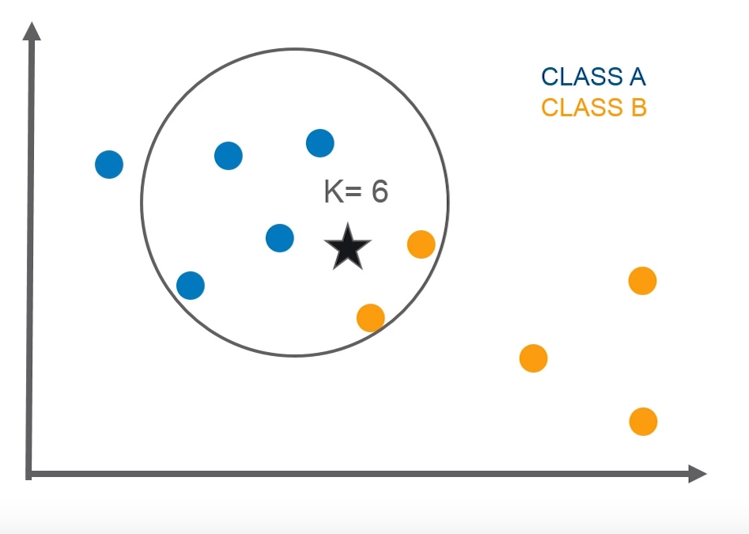

Slide 33
Decision Trees
Why don’t they just call it a flow chart

Slide 34
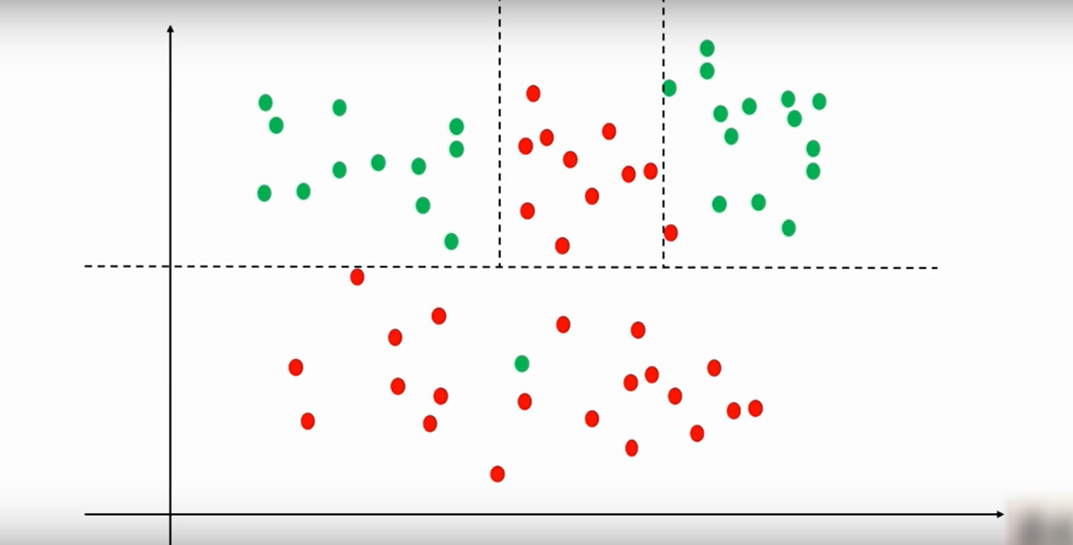

Slide 35
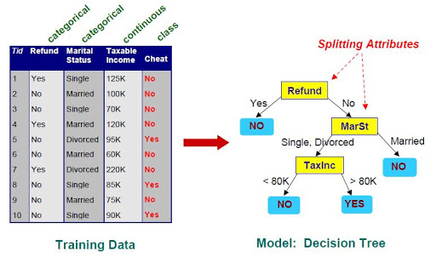

Slide 36
If you’re not done yet… refer to these
Video Index Statquest
ISLR (Really good for statistics and Mathematics)
Pattern Recognition and Machine Learning - By Christopher Bishop
Medium Articles are amazing
Kaggle (You can go to the Notebooks and Kernels section to find solutions to datasets)

Slide 37
That’s a wrap
….a wrap on another day where I pretended to know what i’m doing

